Slide 1
Titan Exercise

Slide 2
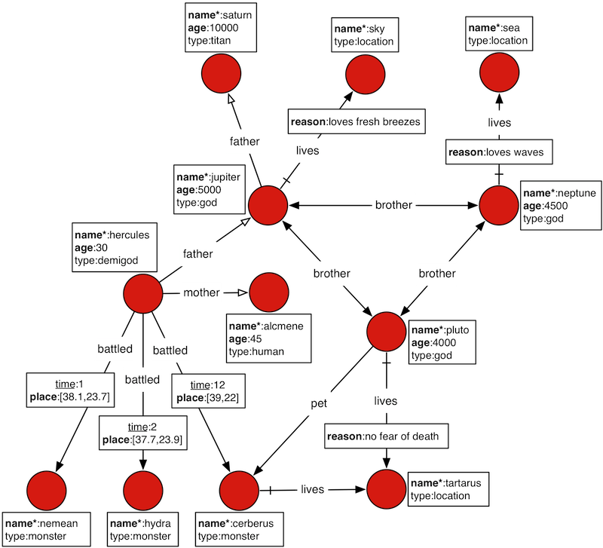

Slide 3
Load Graph
1. INSTALL AND DOWNLOAD
Download Titan (https://github.com/thinkaurelius/titan/wiki/Downloads)
Make sure JDK is installed and JAVA_HOME is set
From unzipped titan download file: bin/gremlin.sh
2. LOAD GRAPH
graph = TitanFactory.open('conf/titan-berkeleyje-es.properties')
GraphOfTheGodsFactory.load(graph)
g = graph.traversal()

Slide 4
Exercises:
Find names of all vertices.
Find what types of vertices we have.
Find what each type consists of.
Find who battled someone.
Save Hercules' index so we can use him.
Find out about Hercules.
Find the name of Hercules' grandfather.
Find Hercules' parents' names.
Find who Hercules has battled more than once.
Find who lives where because they love it.

Slide 5
Expected Output:
4.
==>hercules
==>hercules
==>hercules
5.
==>v[12472]
6.
==>[name:[hercules], age:[30]]
1.
==>nemean
==>sky
==>sea
==>tartarus
==>neptune
==>pluto
==>cerberus
==>saturn
==>jupiter
==>hercules
==>hydra
==>alcmene
2.
==>monster
==>location
==>god
==>titan
==>demigod
==>human
3.
==>[demigod:[hercules], titan:[saturn], location:[sky, sea, tartarus], god:[neptune, pluto, jupiter], human:[alcmene, monster:[nemean, cerberus, hydra]]

Slide 6
Expected Outputs:
7.
==>saturn
8.
==>jupiter
==>alcmene
9.
==>cerberus
==>hydra
10.
==>[god:jupiter, reason:loves fresh breezes, thing:sky]
==>[god:neptune, reason:loves waves, thing:sea]

Slide 7
Solutions:
g.V().values('name')
g.V().label().unique()
g.V().group().by(label).by('name')
g.V().outE('battled').outV().values('name')
hercules = g.V().has('name','hercules').next()
g.V(hercules).valueMap()
g.V(hercules).out('father').out('father').values('name')
g.V(hercules).out('father','mother').values('name')
g.V(hercules).outE('battled').has('time',gt(1)).inV().values('name')
g.E().has('reason',textContains('loves')).as('source').values('reason').as('reason').select('source').outV().values('name').as('god').select('source').inV().values('name').as('thing').select('god', 'reason', 'thing')

